Slide 1
How Selecting the Right Pump Can Minimize Your Total Cost of Ownership and Boost Global Sustainability
Tomas Dobrovolskis

Slide 2
Global Sustainability
Definition
“Meeting the needs of the present without compromising the ability of future generations to meet their own needs.”
Environmental Sustainability Meaning
Conserving natural resources and protecting the environment.

Slide 3
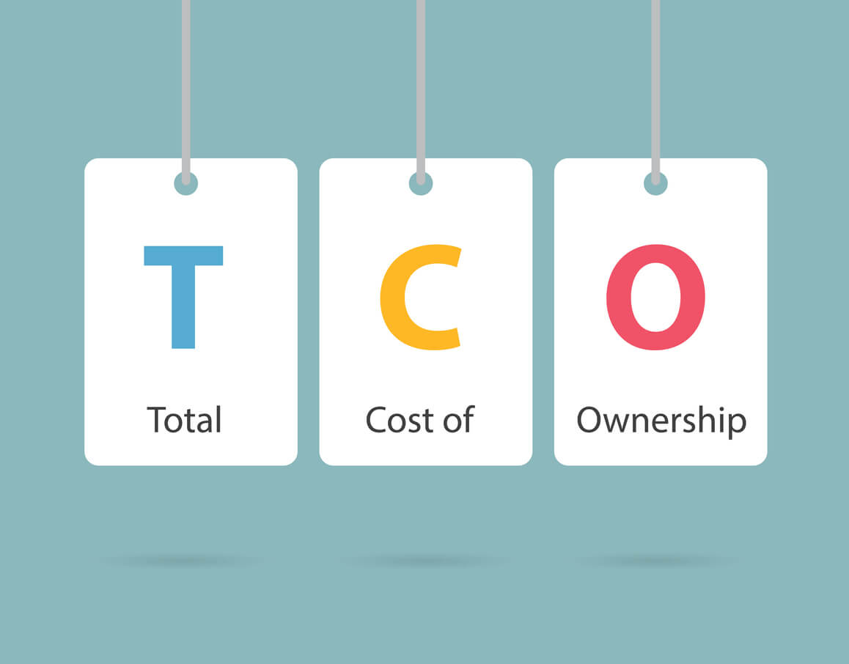
Understanding Total Cost of Ownership (TCO)
Initial
Installation and Commissioning
Energy
Operating
Maintenance
Downtime
Environmental
Decommissioning and Disposal

Slide 4
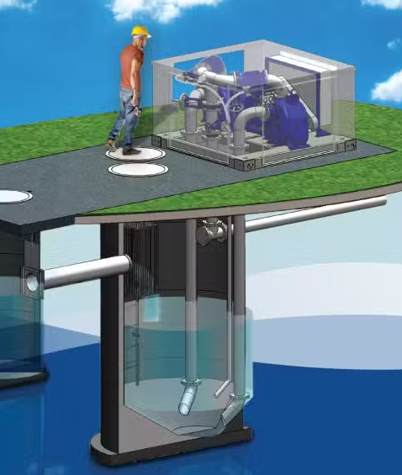
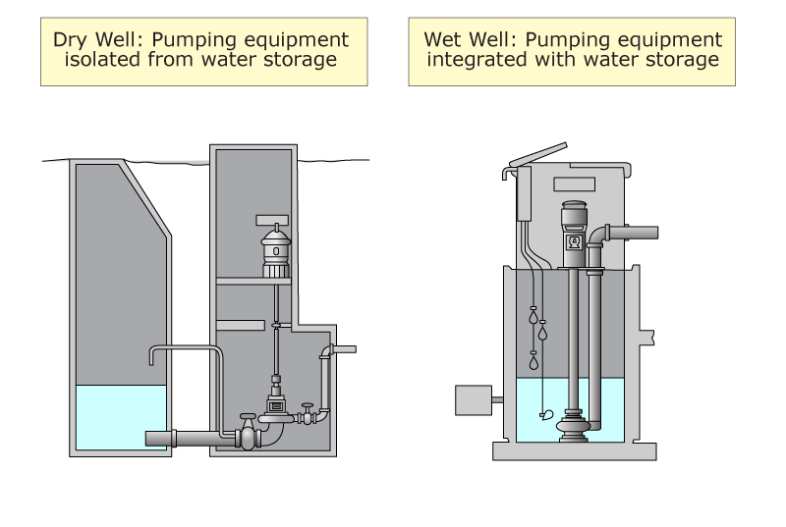
Installation Costs
Types of Installations

Slide 5
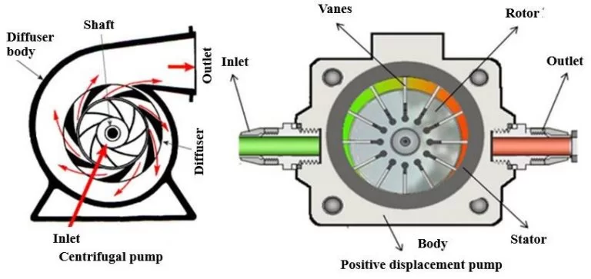
Installation Costs
Types of Pumps

Slide 6
Operating Costs
System Complexity

Slide 7
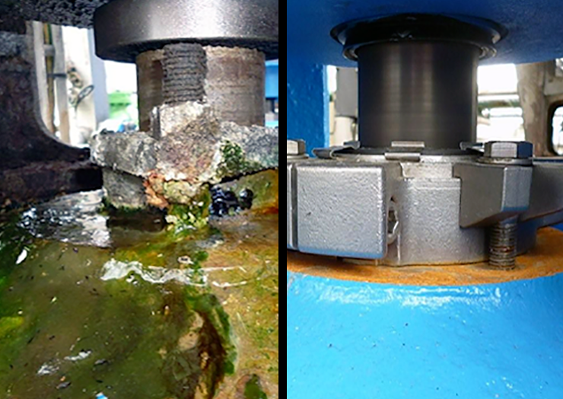
Environmental Costs
Pumped product & pump sealing type

Slide 8
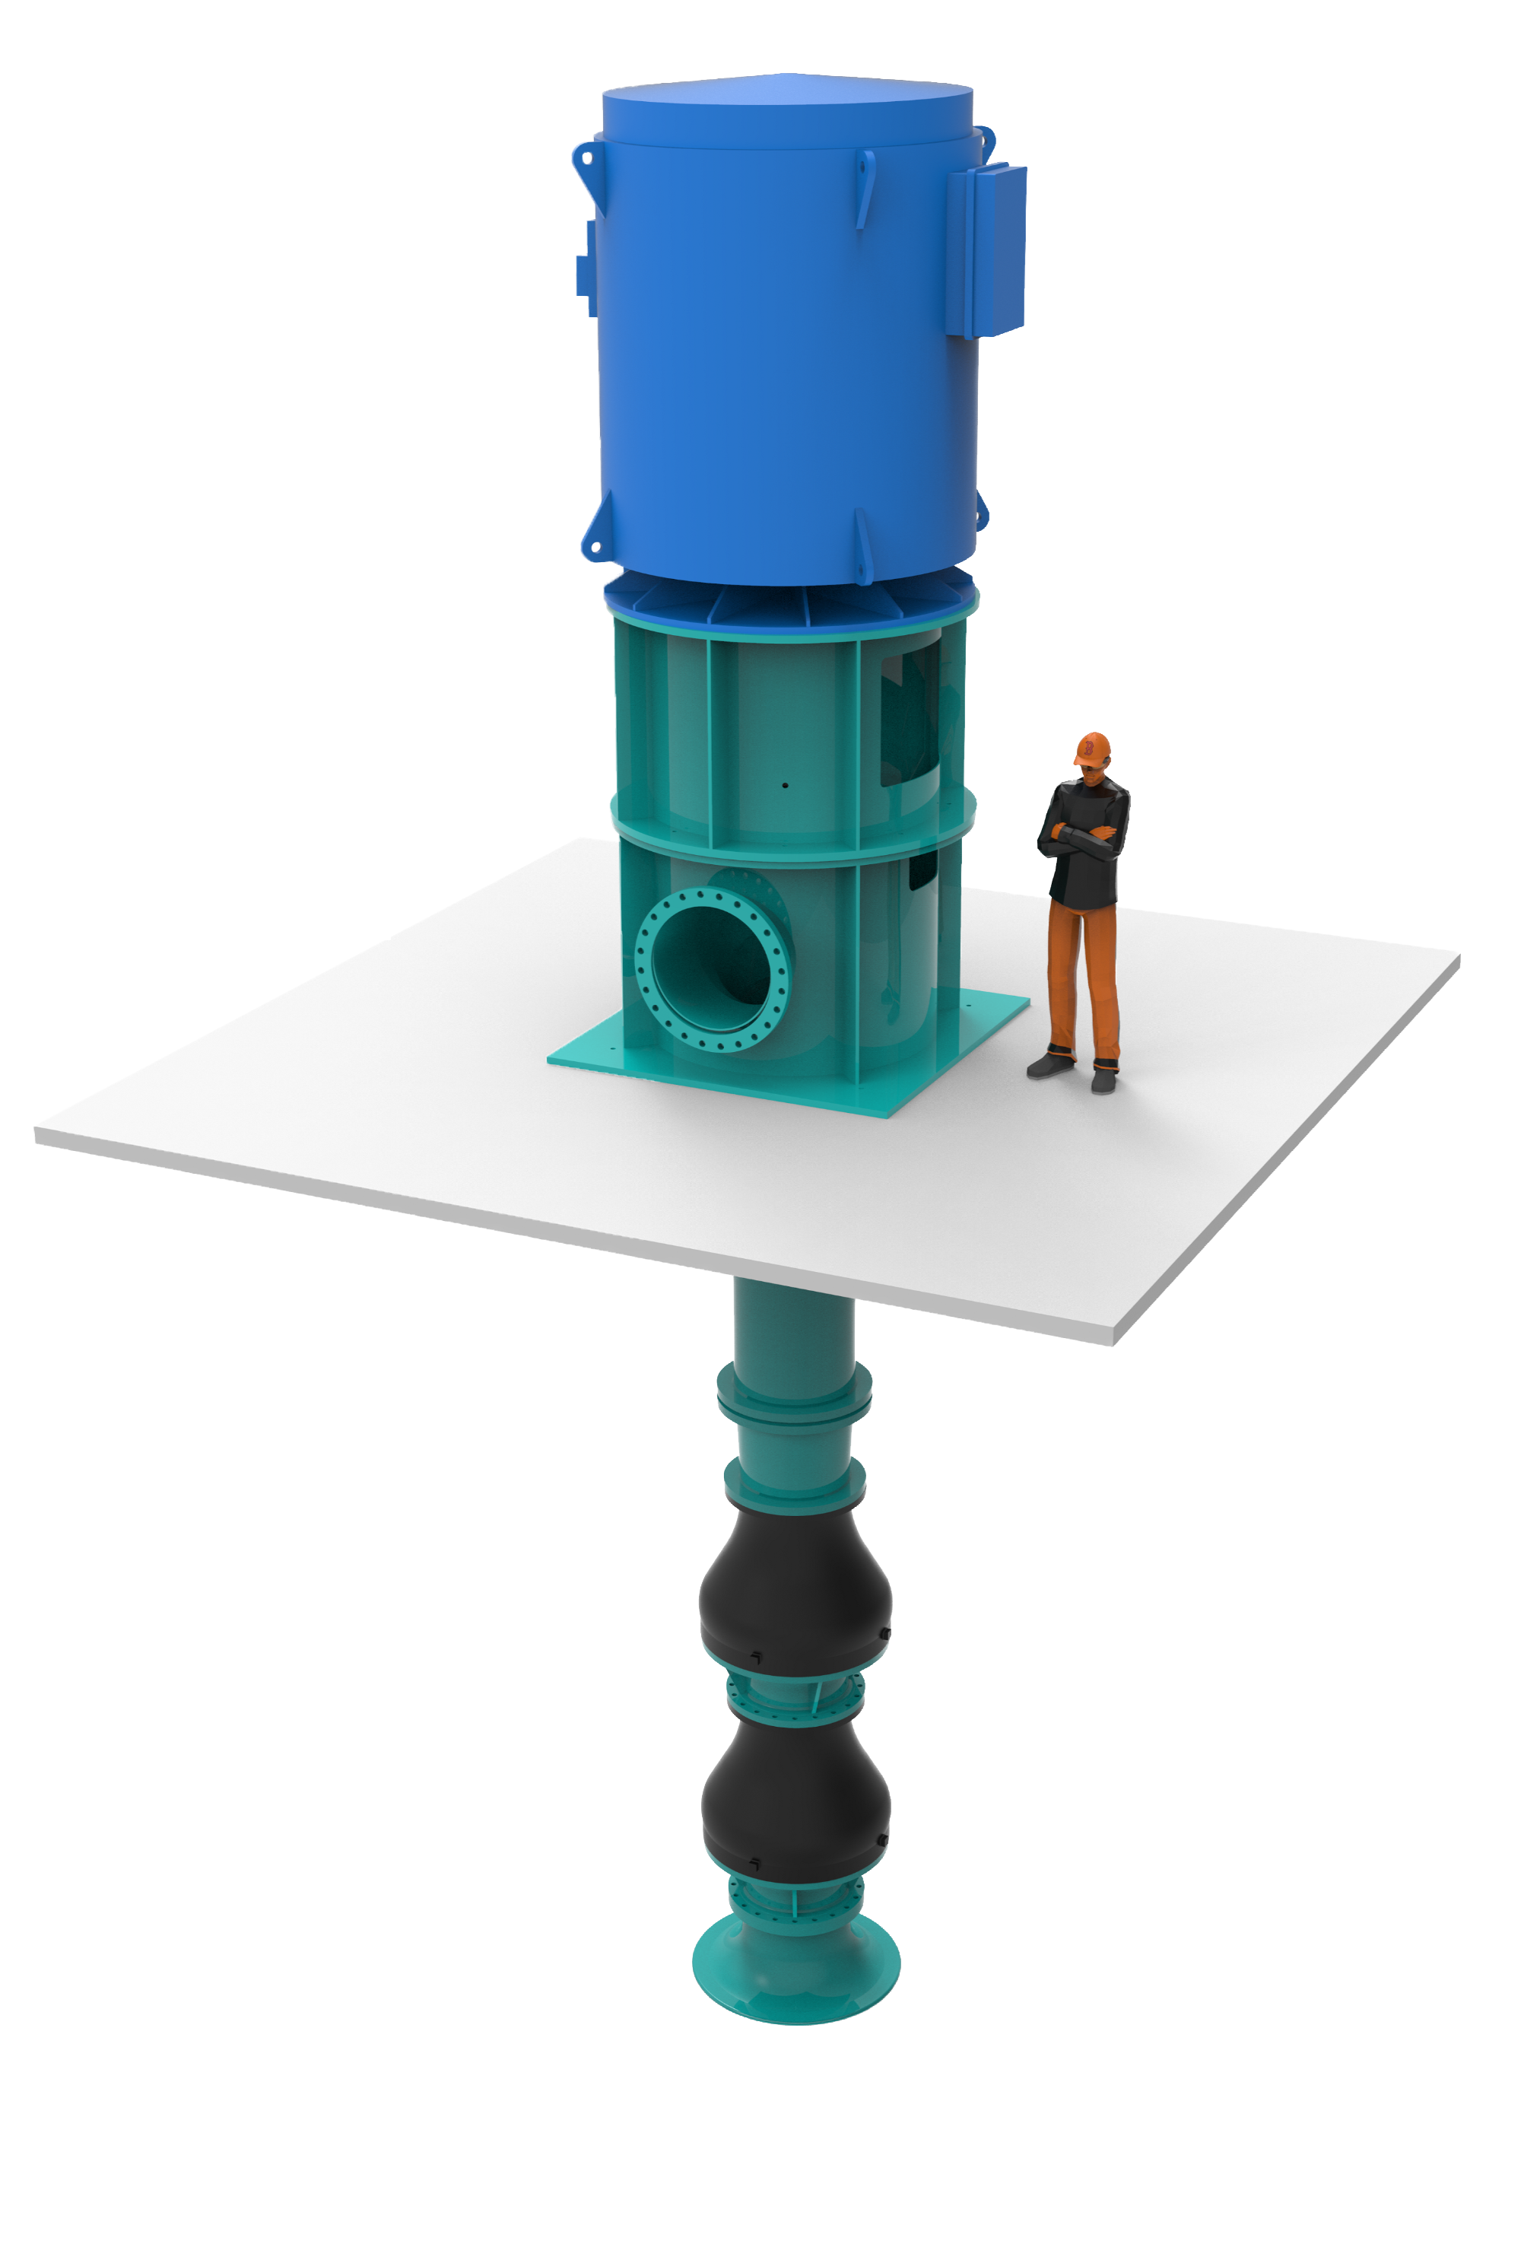
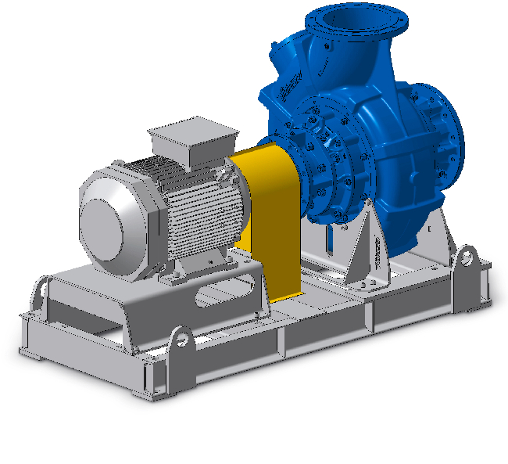
Decommissioning & Disposal Costs
Pump size & materials

Slide 9
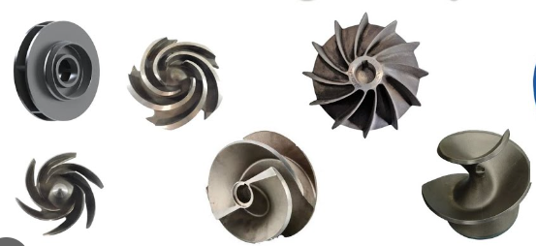
Pump Initial Cost Considerations
Right Pump For The Application
Pump Type
Impeller Type
Pump Size
Installation Type
Notes:
Closed, Vortex, Open, Chopper, Screw Centrifugal

Slide 10
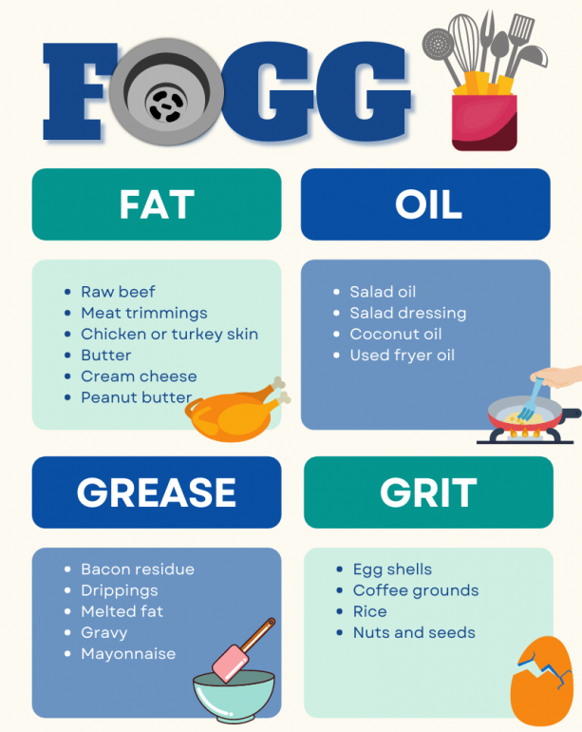
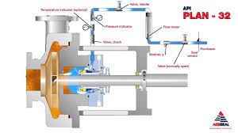
Pump Initial Cost Considerations
Auxiliary Equipment Required (Seal Water)
What can enter the liquid being pumped?
Notes:
Closed, Vortex, Open, Chopper, Screw Centrifugal

Slide 11
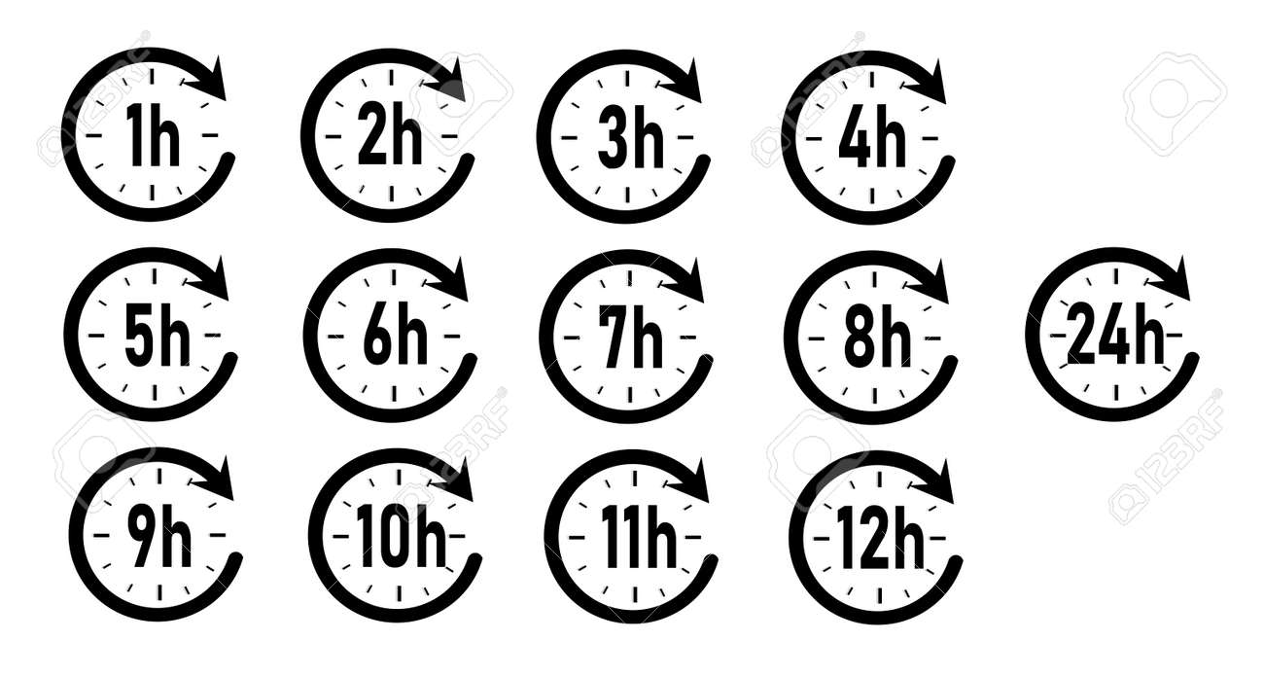
Pump Energy Considerations
Pump power required
Motor efficiency
Utilization – expected run time per year
Electricity Average Price $/kWh
VFD

Slide 12
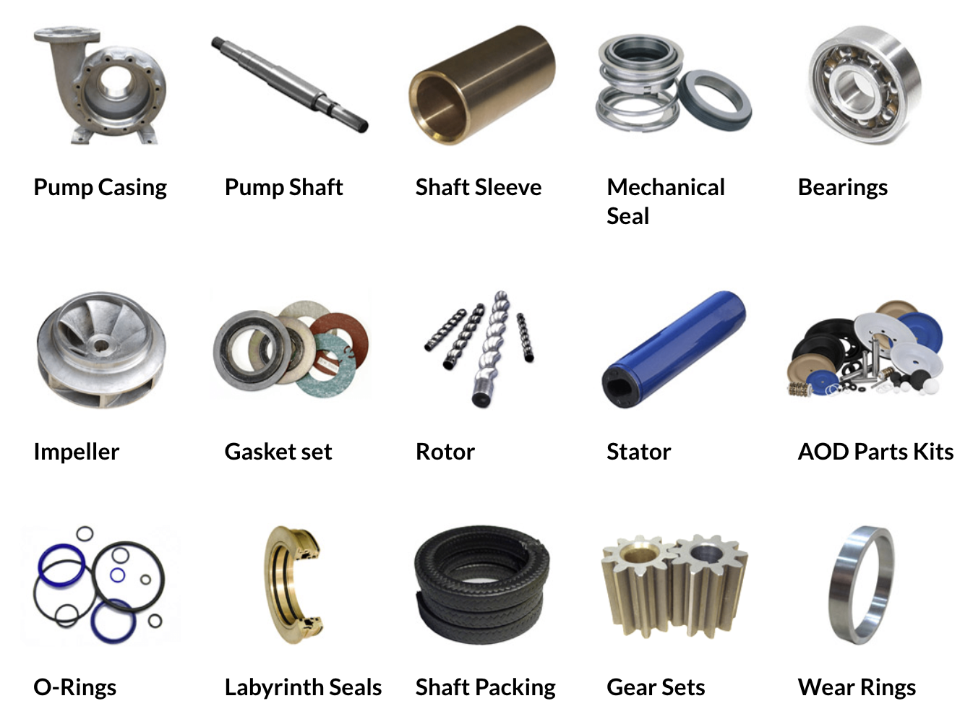
Pump Maintenance Considerations
Routine Maintenance
Repair Labor
Replacement Parts
Loss of Production or Temporary Replacement
Removal & Reinstallation
Inspection
Transportation

Slide 13
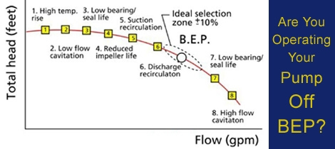
Selecting The Right Pump
Efficiency
What is the efficiency of the pump?
What is the efficiency of the motor?

Slide 14
Selecting The Right Pump
Pump Blockages
What is the uncompressible solid passage size?
Pump that is blocked is 0% efficient

Slide 15
Selecting The Right Pump
Pump Reliability & Durability
What is the expected lifespan 5, 10, 20, 30+ Years?

Slide 16
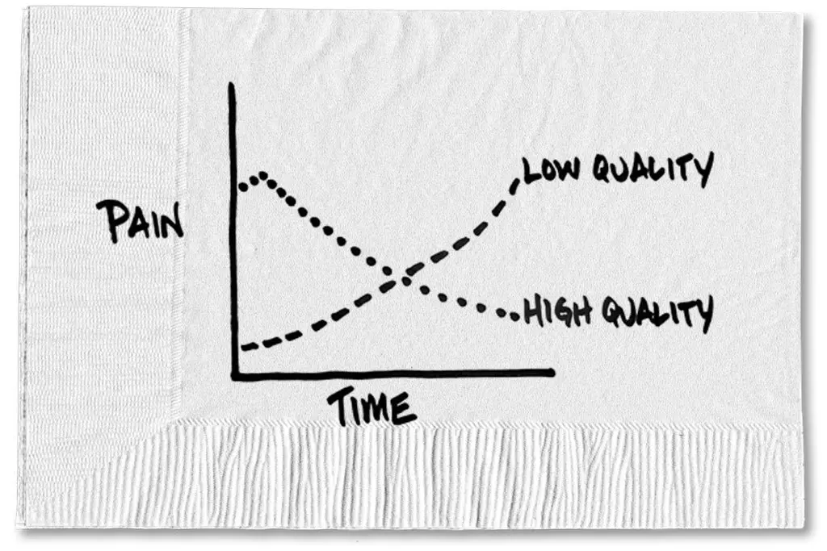
Selecting The Right Pump
Pump Maintenance
What is the expected frequency of repairs based on the size and type of pump?

Slide 17
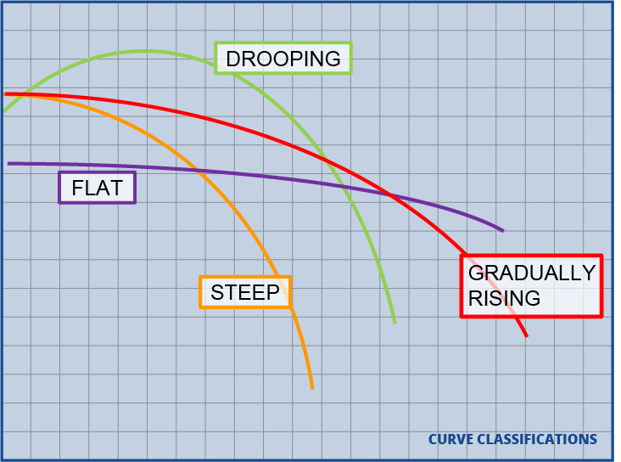
Selecting The Right Pump
Pump Adaptability
Can the pump adapt to changes without the need for new pumps?

Slide 18
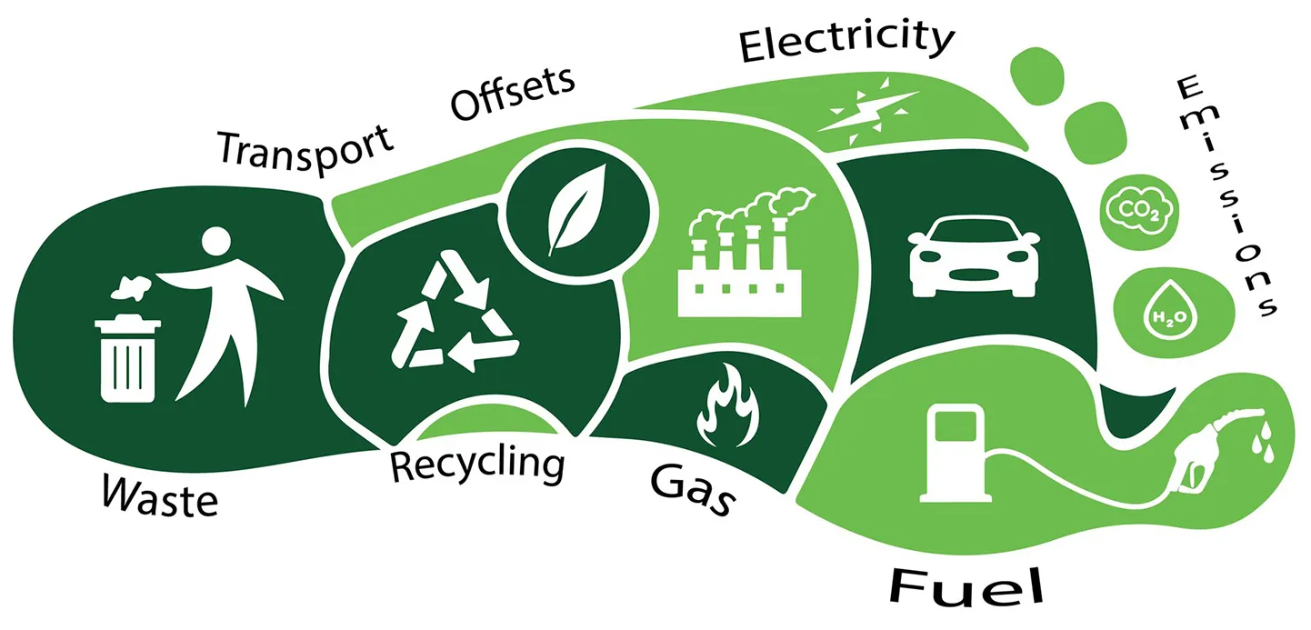
How does it relate to pumps & sustainability?
Energy Costs

Slide 19
How does it relate to pumps & sustainability?
Maintenance Costs
Material Usage

Slide 20
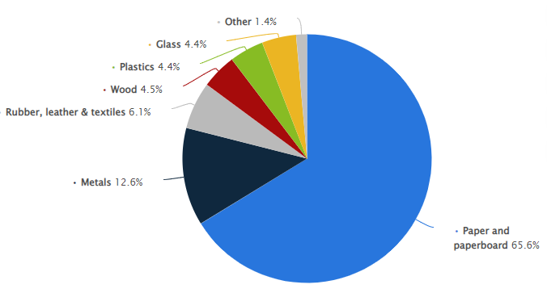
How does it relate to pumps & sustainability?
Decommissioning and Disposal Costs

Slide 21
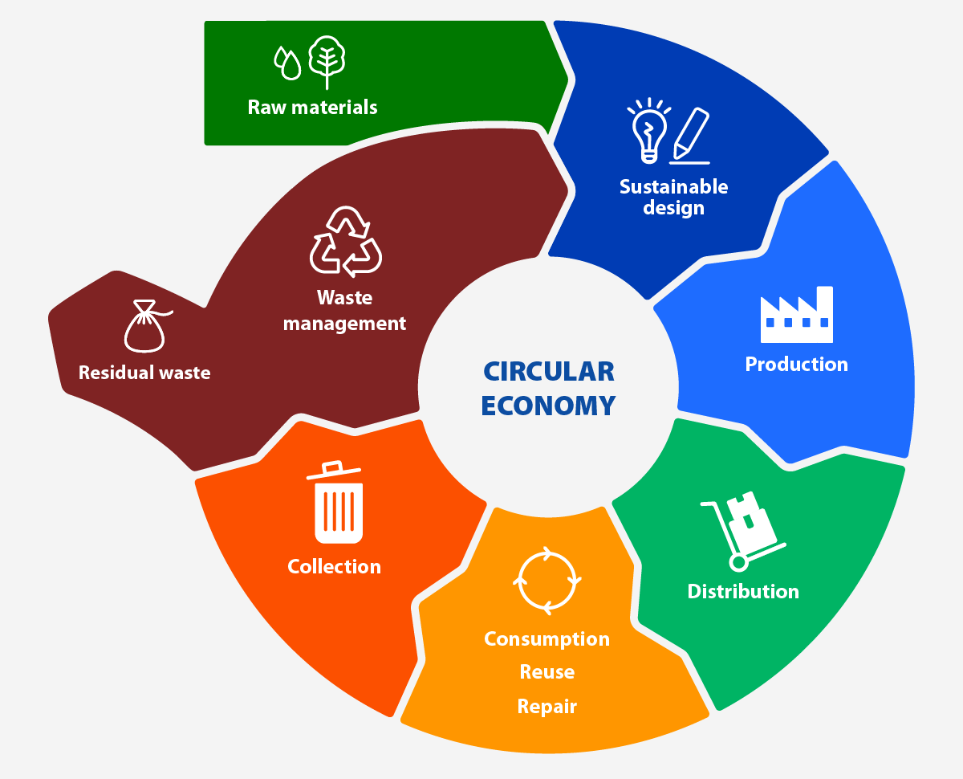
How does it relate to pumps & sustainability?
Environmental Costs

Slide 22
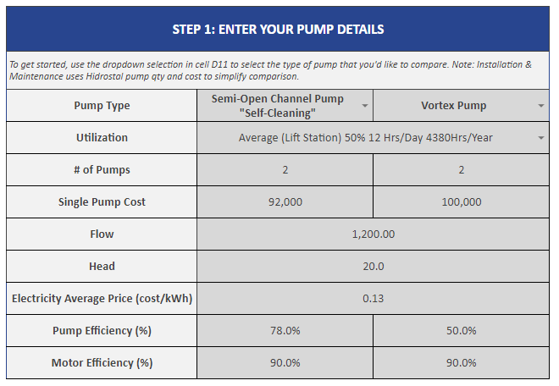
TCO Calculation Information Required
Pump Type
Pump Utilization
Pump Cost
Pump Qty
Electricity $
Pump Efficiency
Motor Efficiency
Expected Lifetime

Slide 23
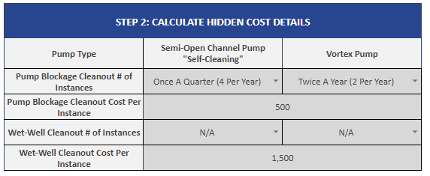
Additional Information (Optional)
How often do current pumps block?
What’s the cost of unblocking?
How often do the current wet-wells get vacuumed out?
What is the cost of cleanout?

Slide 24
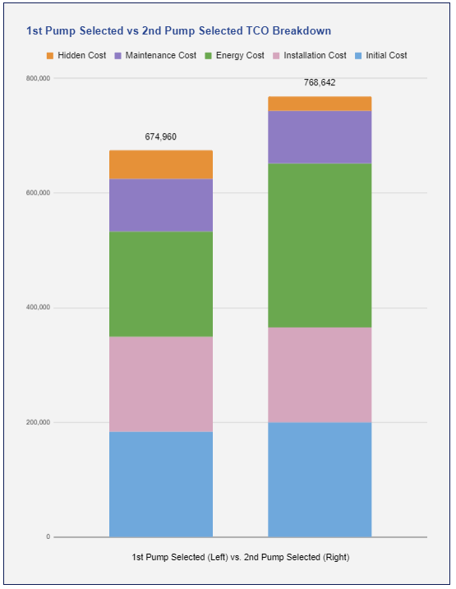
Results
TCO Summary

Slide 25
Summary
Run calculations for current setup
Run calcs for alternative options
https://docs.google.com/spreadsheets/d/1obOBybLJMA6oP3VX8z-aGNDQUt7JBAP4w0mI2B9UGek/edit?usp=sharing

Slide 26
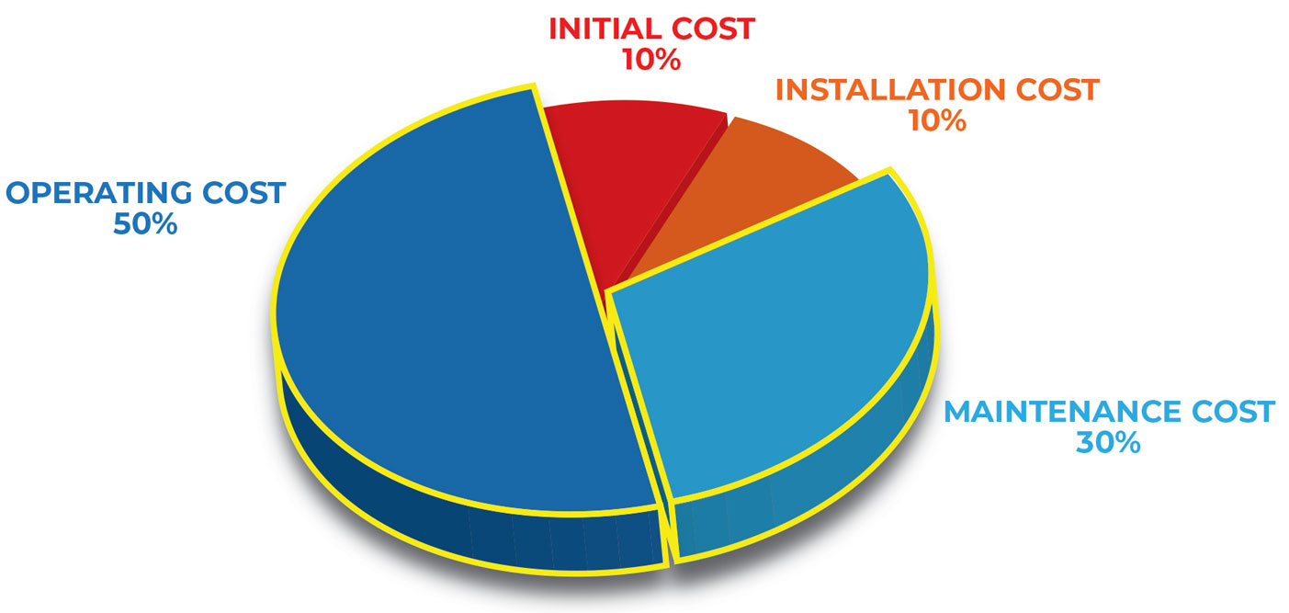
Conclusion
TCO & the Global Impact on Sustainability

Slide 27
Why is it important to me?

Slide 28
Thank you!

