Slide 1
Technology’s Impact of Decision Making In Our Industry’s Future
Gakuo Ndonga
Senior Engineer
WD Bearings America LLC

Slide 2
What Role Do Our Decisions Play In Society?

Slide 3
• Customer First
• Co-creation and Sharing
• Integrity and Professionalism

Slide 4
Ethics, Integrity & Professionalism (EIP)

Slide 5
EIP In The Industry
Ethics
Integrity
Professionalism
A set of moral principles
Ex. Politically targeted ads will not reach minors

Slide 6
EIP In The Industry
Ethics
Integrity
Professionalism
Adherence to a code
Ex. Refusal to lie, steal, or deceive

Slide 7
EIP In The Industry
Ethics
Integrity
Professionalism
Courteous, conscientious, and business like manner
Ex. Will evaluate job candidates equally

Slide 8
Our Industry Today
Asset 56P critical!
Initiate shelter in place!
Field team evacuated, response teams on site
Investigate root cause and assess impact

Slide 9
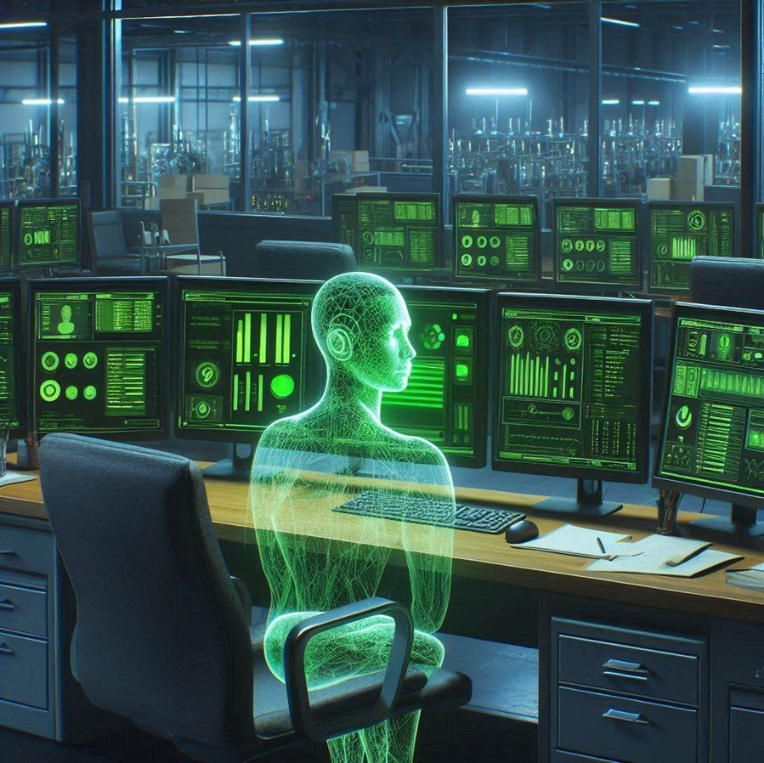
Our Industry Tomorrow
All assets operational
Increase speed by 30% of assets 1-9
Manual inlet valve failure
Asset 10 offline, fatalities expected

Slide 10
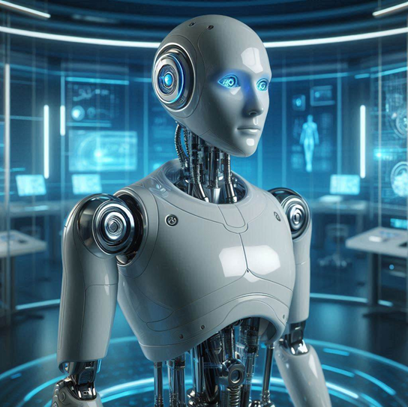
Age
of
AI

Slide 11
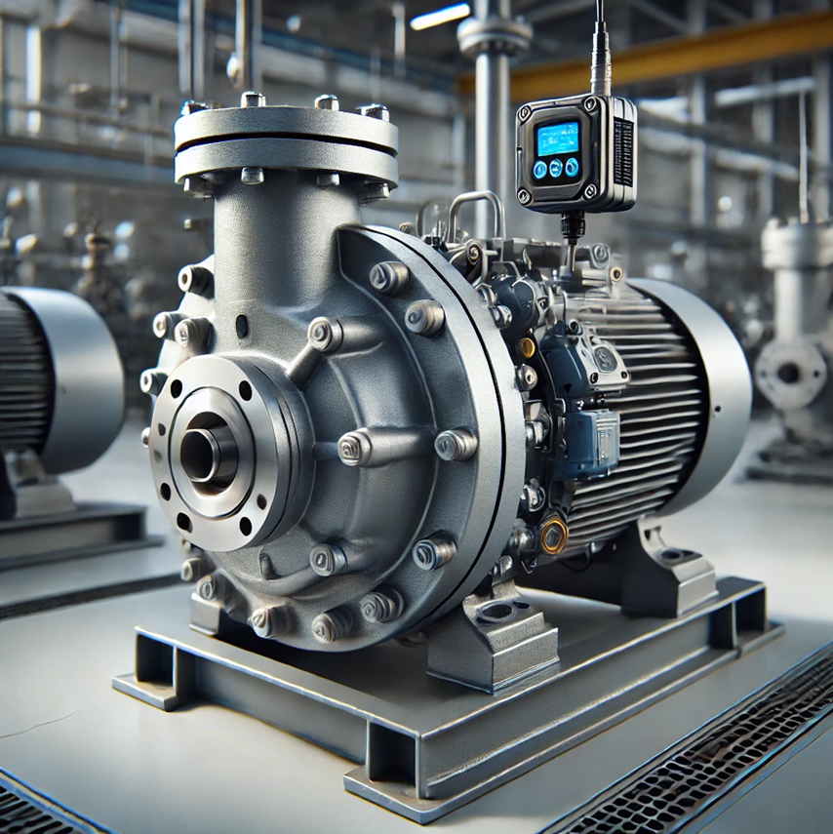
Artificial Intelligence and Pumps
AI 1.0
AI 2.0
Raw data processing
Generic thresholds
Process data collection
Data filtration
Subject matter insight/programming
Cavitation
Seal face wear
Bearing fatigue damage
Low suction pressure
Inspect upstream pipes & valves
Pump failure imminent
Stop operations
Clear blockages and obstructions
Systems at 65% efficiency

Slide 12
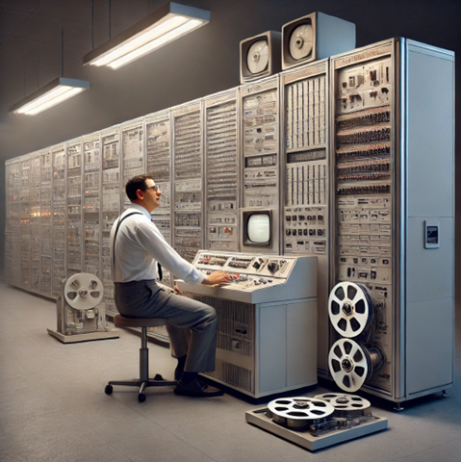
As Technology Evolves, So Must Our Practices
Chemistry
Physics
Health
Safety
Art
Infrastructure
Military
Agriculture
Communication
Education
Business
Healthcare
?
Containment
Suppression
Material Grades
Quality Standards
Usage Regulations
Coding Languages
Human Interfaces
Storage Standards
?

Slide 13
The First EIP Decision Lies With You
Education
When
Workplace
Why
Social Media
Healthcare
How
Nutrition
Entertainment
What
Defense

Slide 14
Thank you for attending!
This presentation was brought to you by Artificial Intelligence
For any questions please feel free to contact ChatGPT, CoPilot, or Gemini directly

